Slide 1
Fiji – 8 weeks (left) / 9 weeks (right)

Slide 2
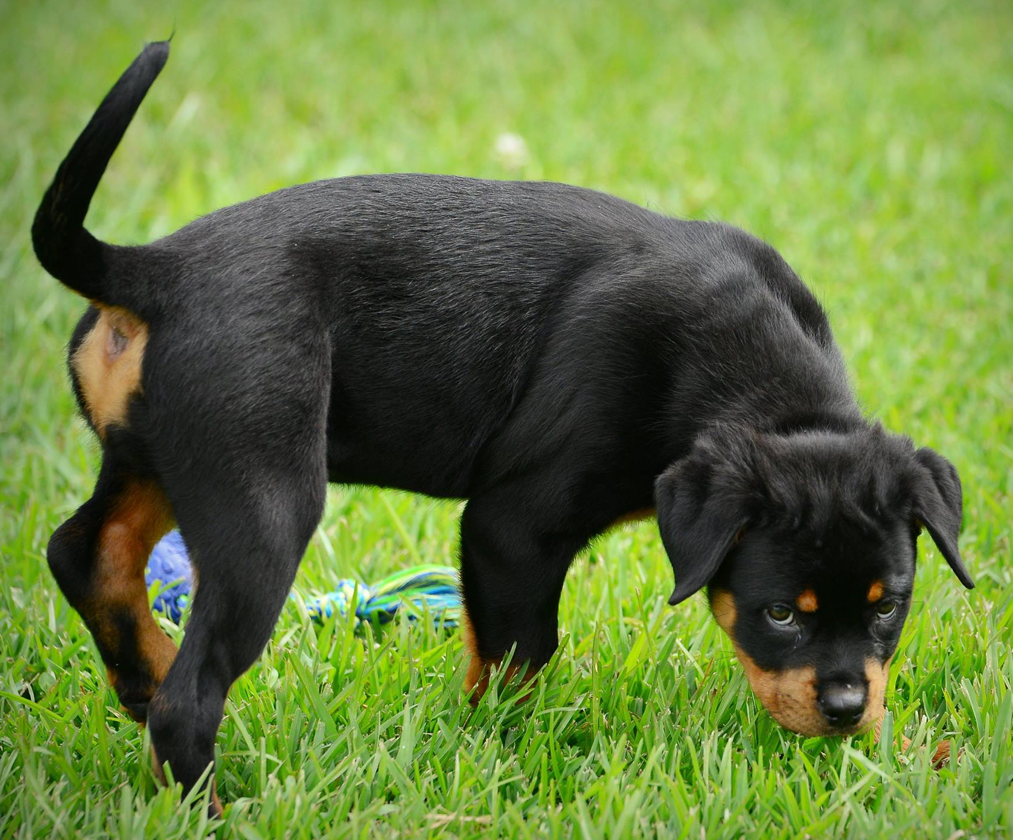
Fiji – 11 weeks (left) / 13 ½ weeks (right)

Slide 3
Fiji - 3 ½ months (left) / 5 months (right)

Slide 4
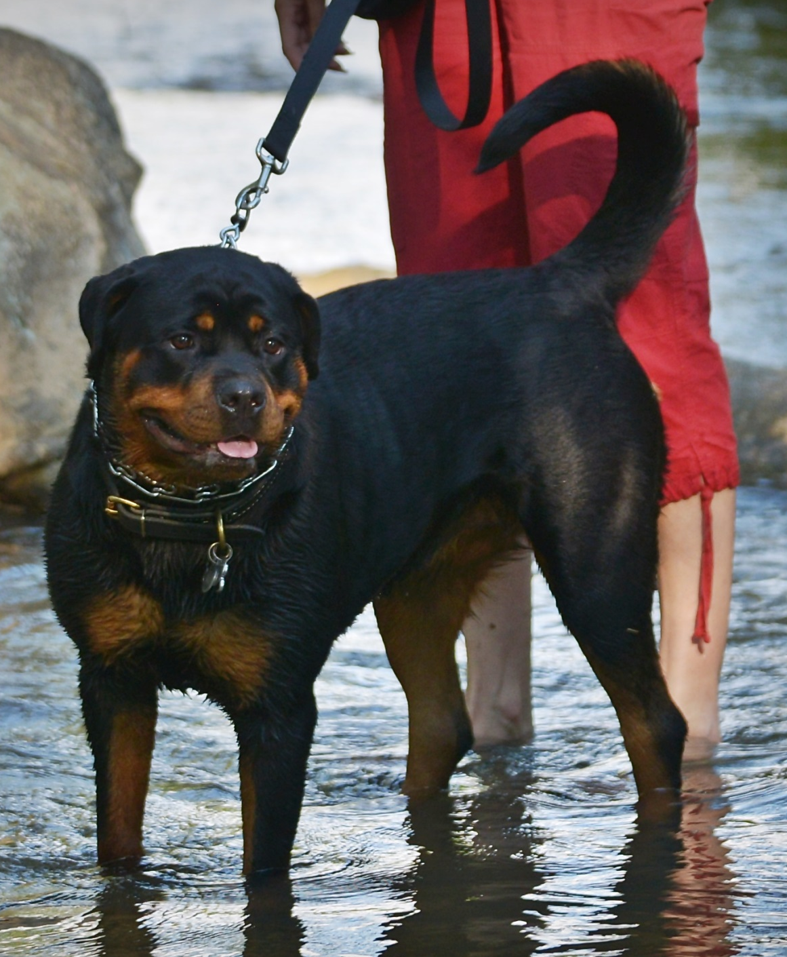
Fiji – 9 months (left) / 11 months (right)

Slide 5
Zarabi / Fiji

